Slide 1

Changchun New Industries Optoelectronics
Tech. Co., Ltd.
STA-LFNT (Ultra) Low-Frequency Noise Testing System
Changchun Institute of Optics, Fine Mechanics and Physics, Chinese Academy of Sciences
Changchun New Industry Optoelectronics Technology Co., Ltd.

Slide 2
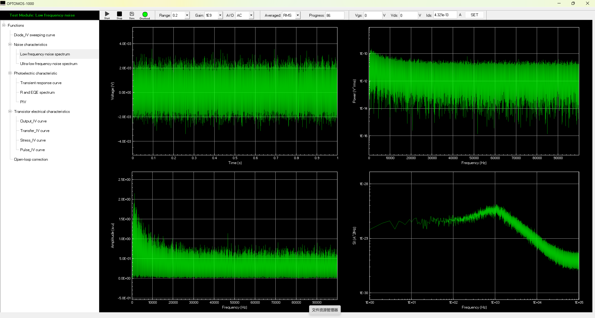
Software Interface

Slide 3
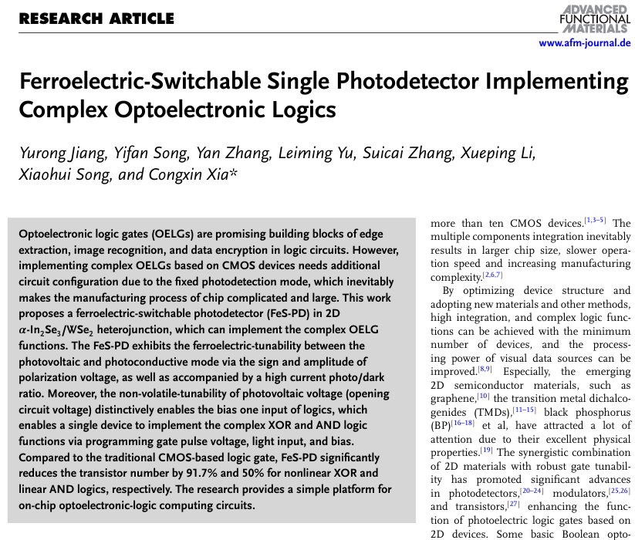
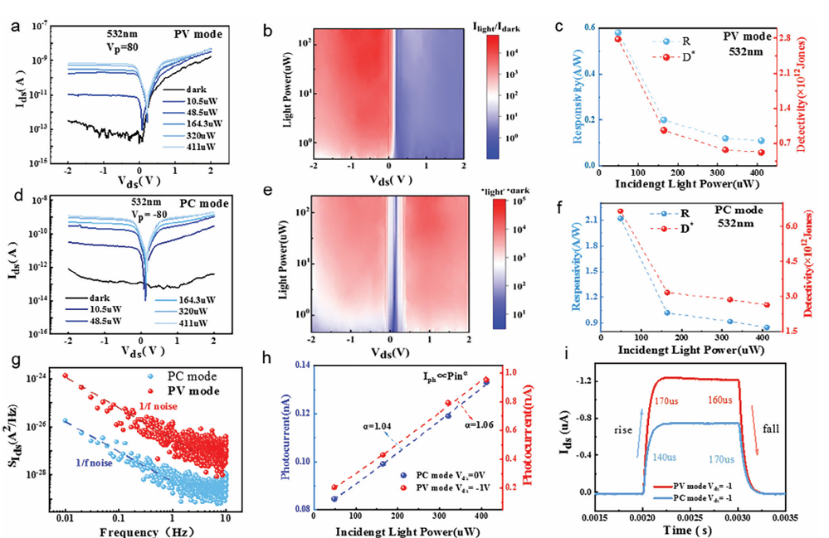
Use Case
The STA-LFNT (Ultra) Low-Frequency Testing System has been used at research institutions and universities such as Tsinghua University, Nanjing University, Harbin Institute of Technology, Dalian University of Technology, Changchun Institute of Applied Chemistry, Changchun University of Science and Technology, Nanjing University, Jiangnan University, Henan Normal University, Southwest University, Xiamen University, Ningbo University, Nanhua University, and Heilongjiang University.

Slide 4
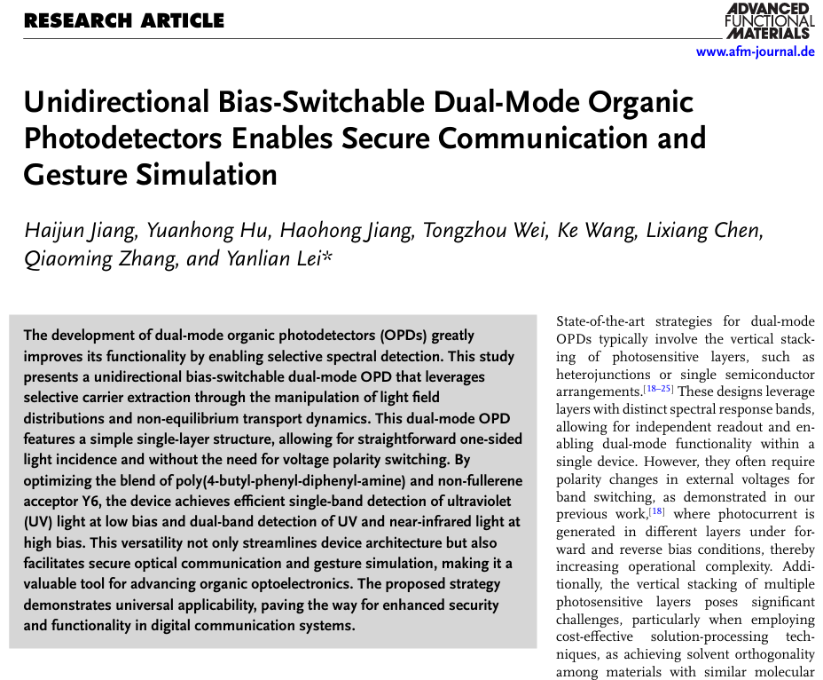
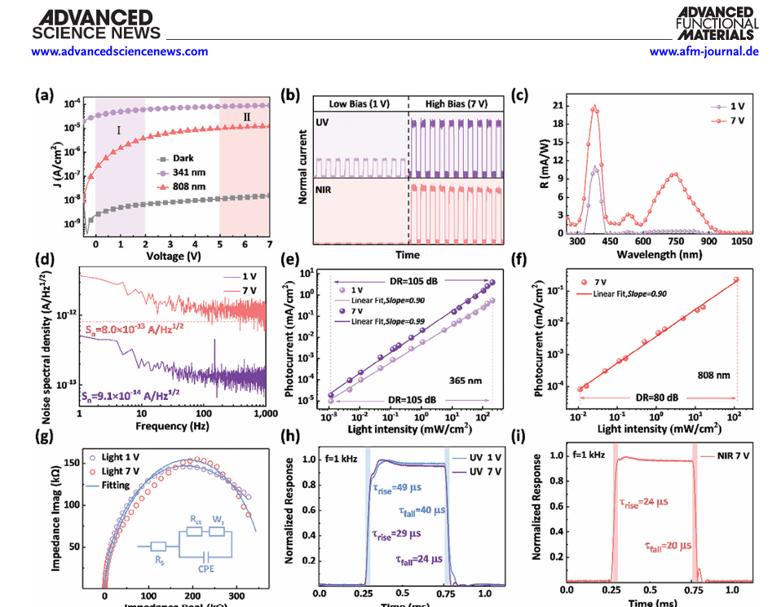
Use Case

Slide 5
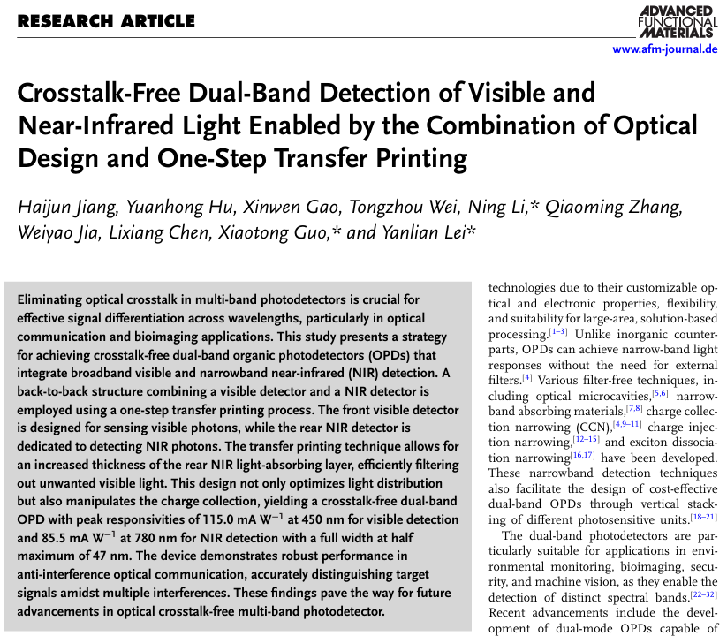
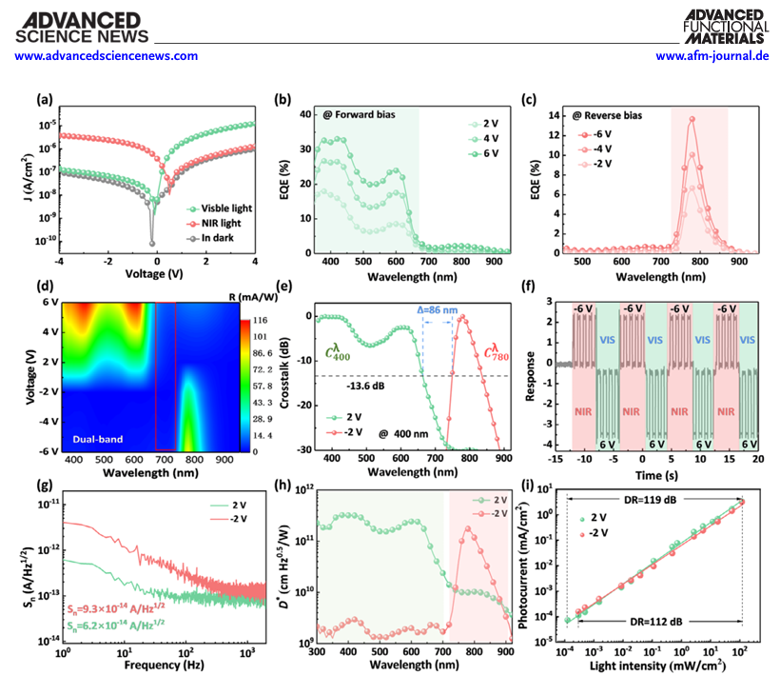
Use Case

Slide 6
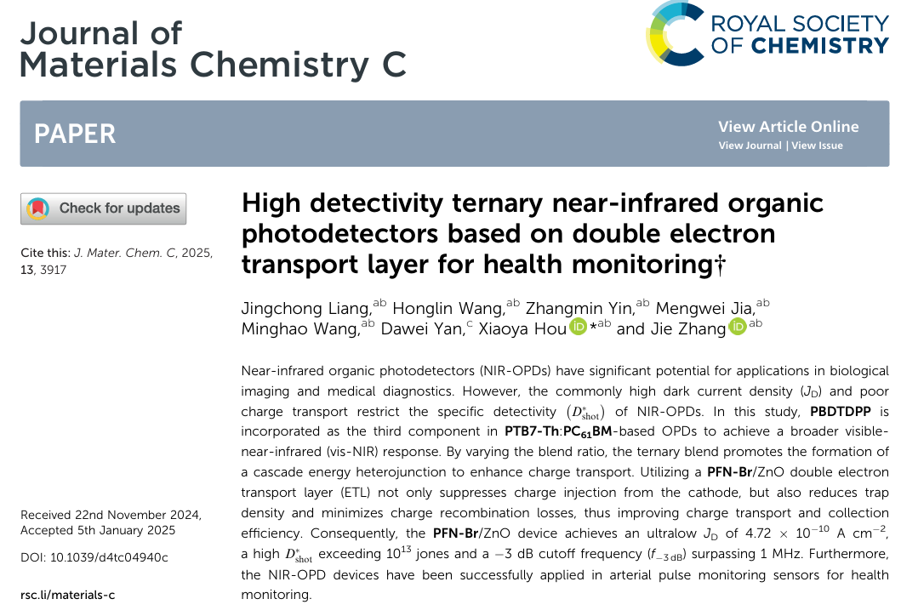
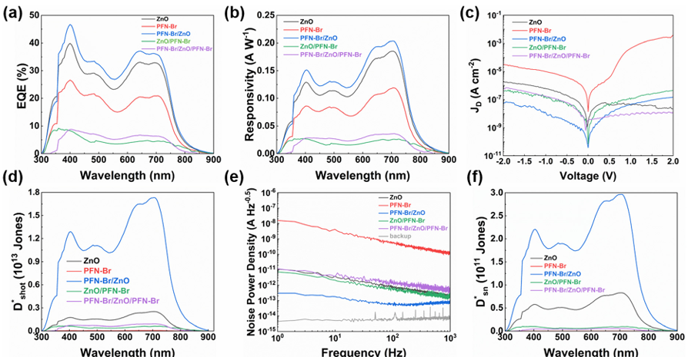
Use Case

Slide 7
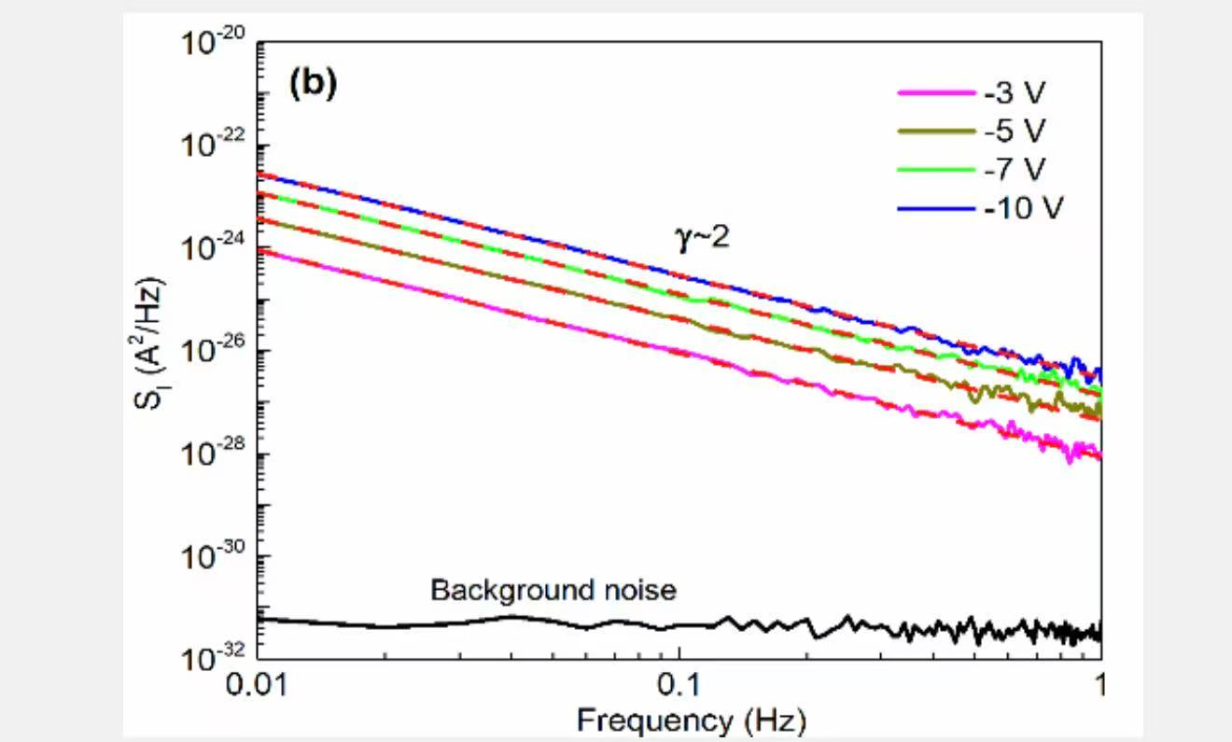
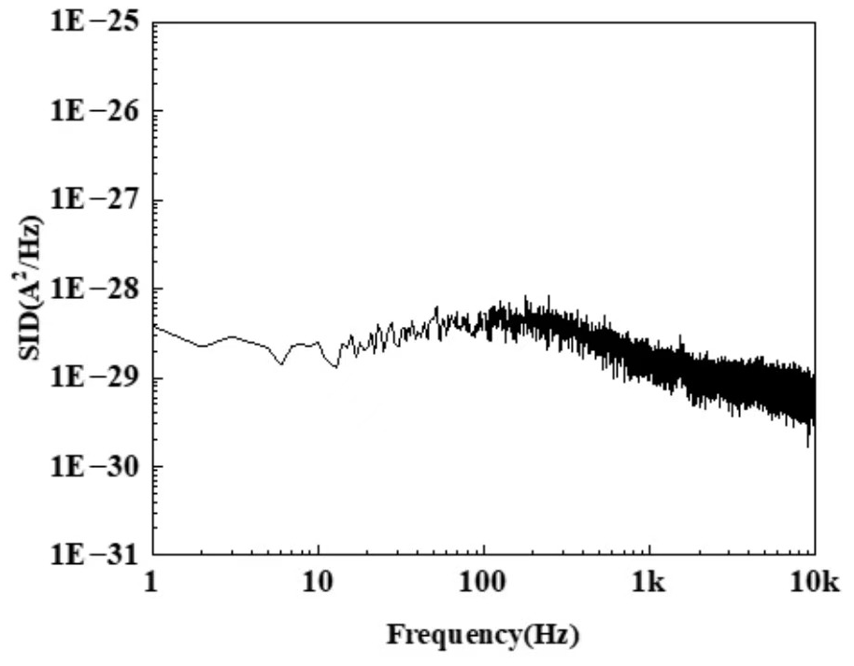
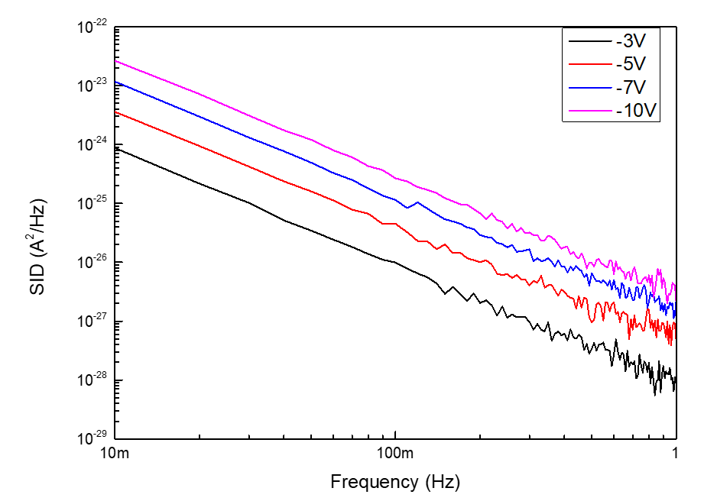
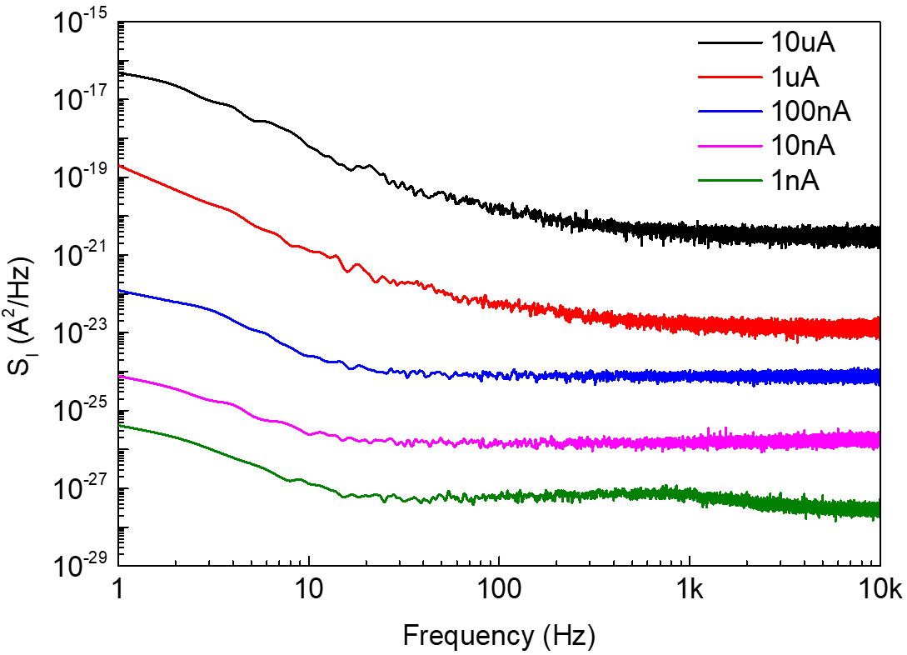
Use Case

Slide 8
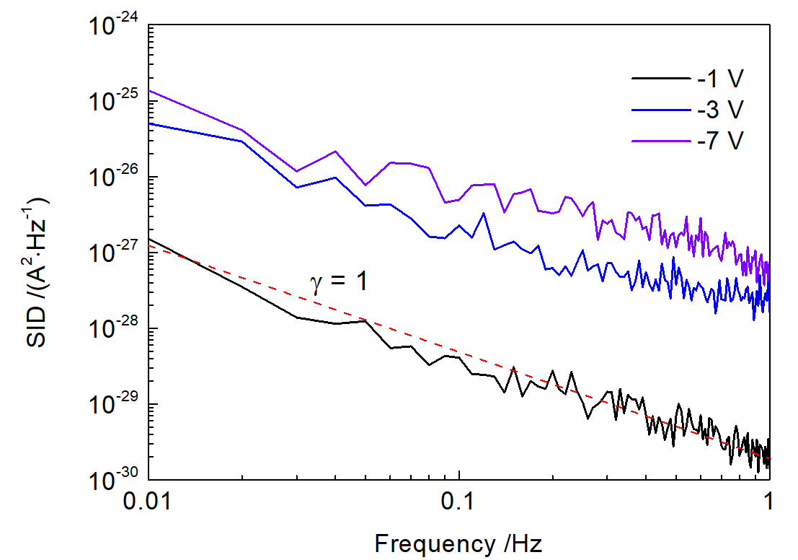
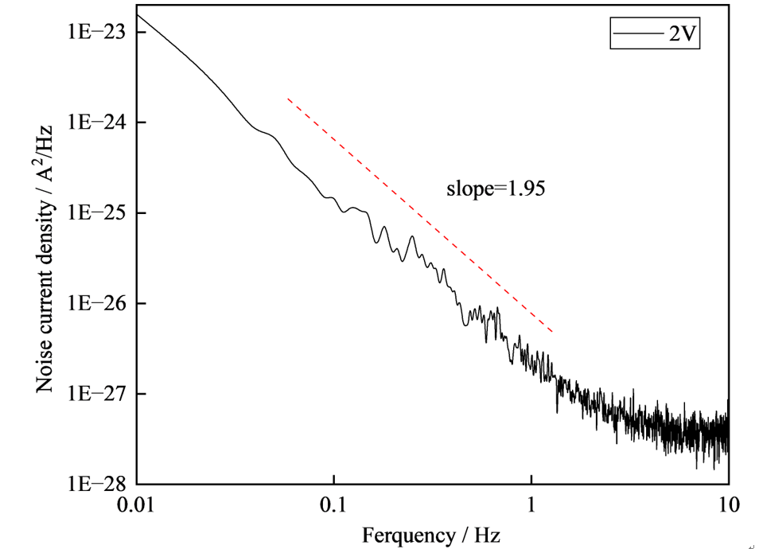
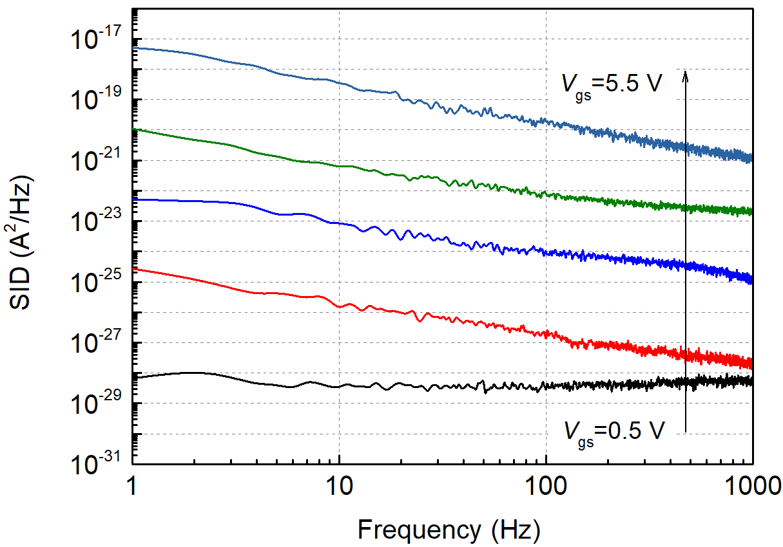
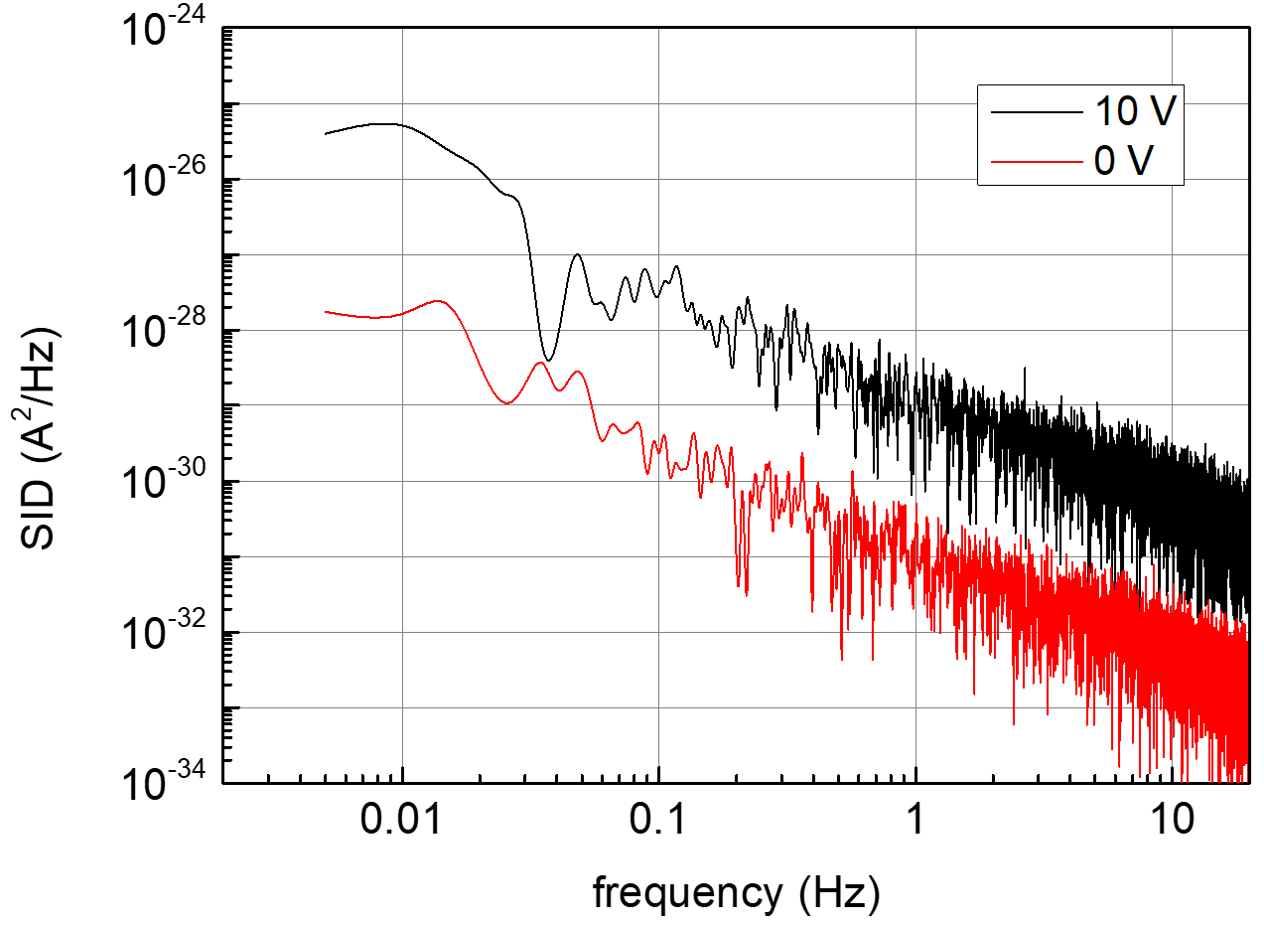
Use Case

